Slide 1
SKA Pathfinders and precursors
- where are we now?
Matt Jarvis
University of Oxford/University of the western cape

Slide 2
SKA Pathfinders and precursors
- where are we now?
Matt Jarvis
University of Oxford/University of the western cape
With a many thanks to
Ian Heywood, Catherine Hale, Anastasia Ponomareva, Russ Taylor, Ray Norris, Andrew Hopkins, Keith Bannister, Rob Fender, Betsey Adams, Lister Staveley-Smith, Patrick Woudt, Fernando Camilo, Aris Karastergiou, James Allison

Slide 3
To do this kind of science we need
Some might argue we have too many pathfinders and precursors…
MeerKAT
ASKAP
APERTIF
LOFAR
MWA
eMERLIN
JVLA
uGMRT
(apologies if I’ve missed your favourite)
However, these all have different science aims and test different parts of what the SKA is planned to be

Slide 4
To do this kind of science we need
Some might argue we have too many pathfinders and precursors…
MeerKAT – many dish, high-sensitivity at mid-frequencies (SKA Mid)
ASKAP – dishes with PAFs, wide FoV at mid-frequencies (SKA Phase X)
APERTIF - dishes with PAFs, wide FoV at mid-frequencies (SKA Phase X)
LOFAR – low-freq, many stations, long baselines, large core (SKA Low)
MWA – low-freq, short baselines, at Murchison (SKA-Low)
eMERLIN – Sparse dish array, long baselines, high-sensitivity (SKA Mid/long baselines)
JVLA – many dish, high sensitivity, small FoV, all-frequencies (SKA Mid)
uGMRT – many dish, high sensitivity, low-mid freq (SKA Mid)
However, these all have different science aims and test different parts of what the SKA is planned to be

Slide 5
SKA Key Science
APERTIF
Cosmology
ASKAP
Continuum
Transients
MeerKAT/JVLA
HI and Spectral Lines
uGMRT
Pulsars
LOFAR
Magnetism
MWA
Epoch of Reionisation
eMERLIN

Slide 6
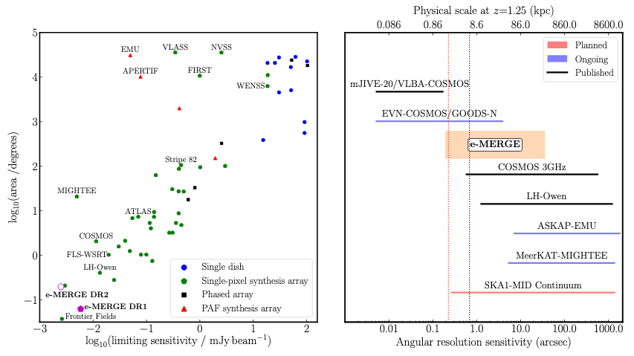
Muxlow et al. 2020

Slide 7
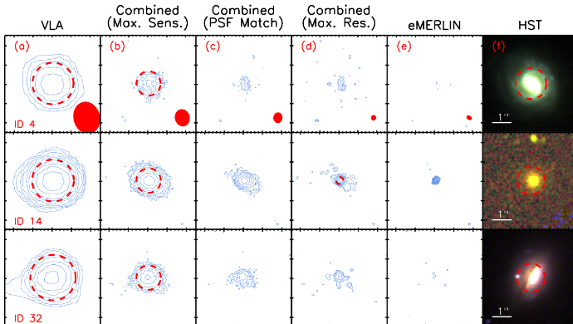
eMERLIN & eMERGE
Muxlow et al. 2020

Slide 8
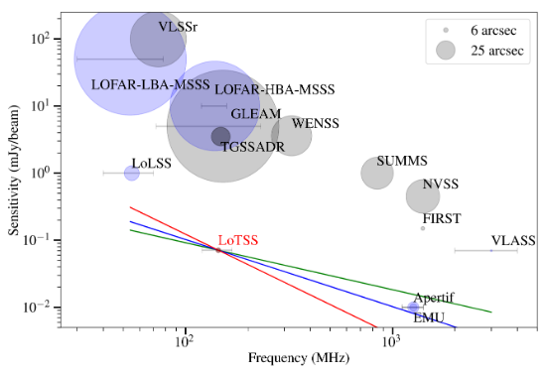
LOFAR Two-metre Sky Survey
Shimwell et al. 2019

Slide 9
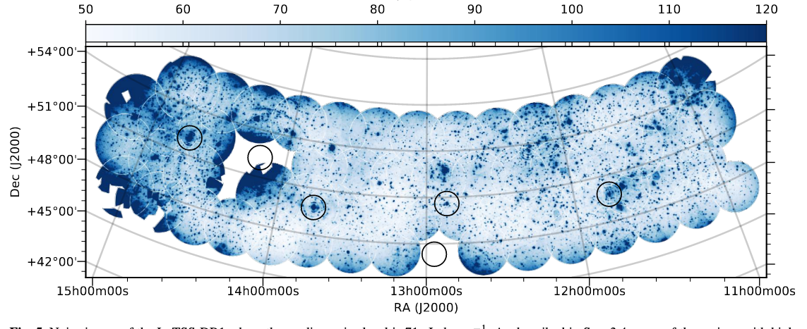
LOFAR Two-metre Sky Survey
Shimwell et al. 2019

Slide 10
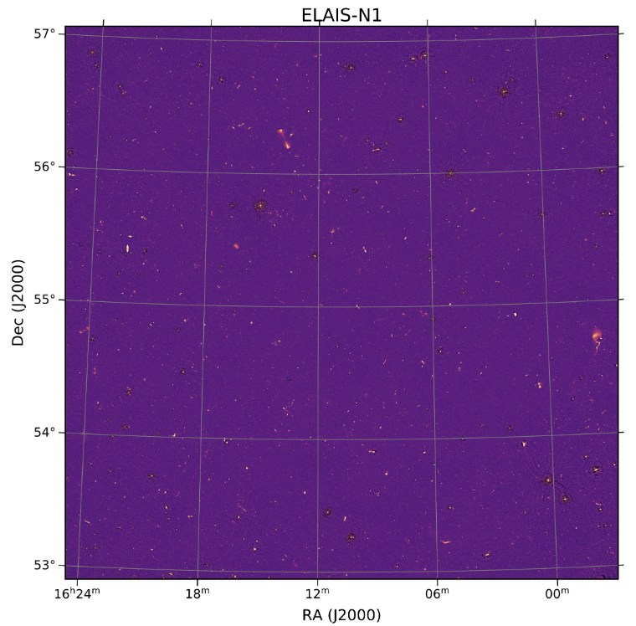
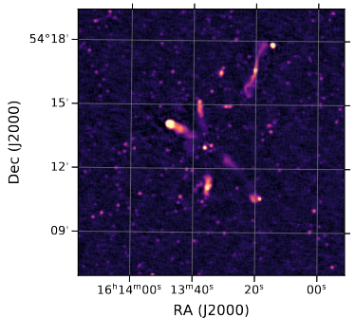
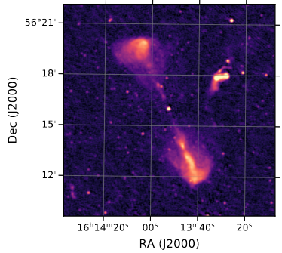
LOFAR Deep Fields
Sabater et al. 2021

Slide 11
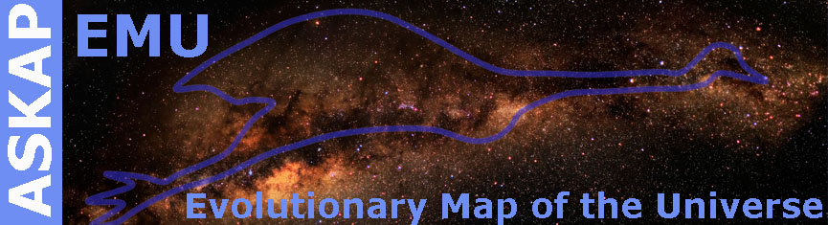
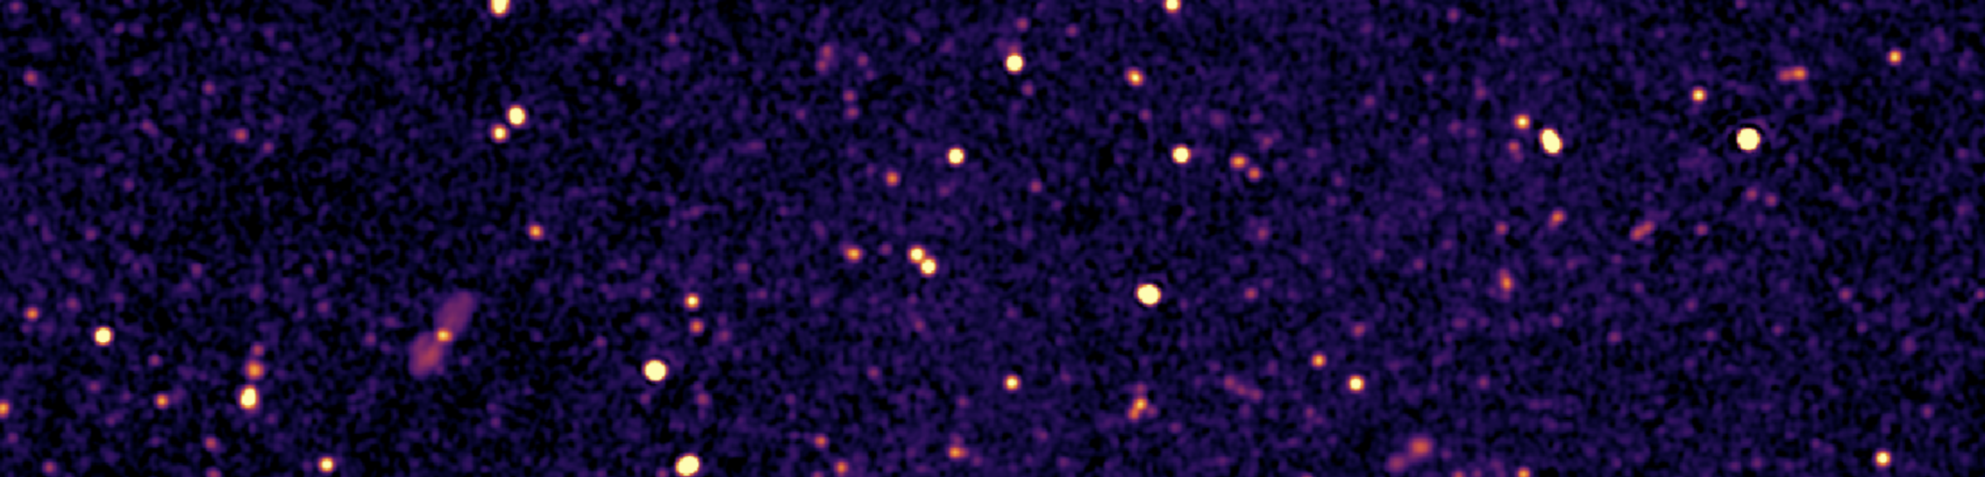
ASKAP - The Evolutionary Map of the Universe (EMU)
Covers the Southern Hemisphere up to Declination of +30º (30000 sq. deg.)
anticipated noise level of ~15µJy, resolution of ~12″ to 15″ FWHM. Expect to detect up to 70 million sources.
Collaboration has about 400 members internationally. Open collaboration: Anyone can ask to join, if intending to contribute, and agreeing to follow publication policy. Contact the EMU Management Team (Andrew Hopkins, Josh Marvil, Tessa Vernstrom, Anna Kapinska): O365-Group-EMU_Management@mq.edu.au
Early data taken during commissioning and early science phases, including G23 field (~60 sq. deg.), and the EMU Pilot Phase 1 (~250 sq. deg., ~25µJy rms, ~300,000 source components),
Over a dozen papers already published with a handful recently submitted, and more than 40 approved and various stages of progress.
EMU website: www.emu-survey.org EMU team wiki: askap.pbworks.org EMU team Slack workspace: emunetwork.slack.com

Slide 12
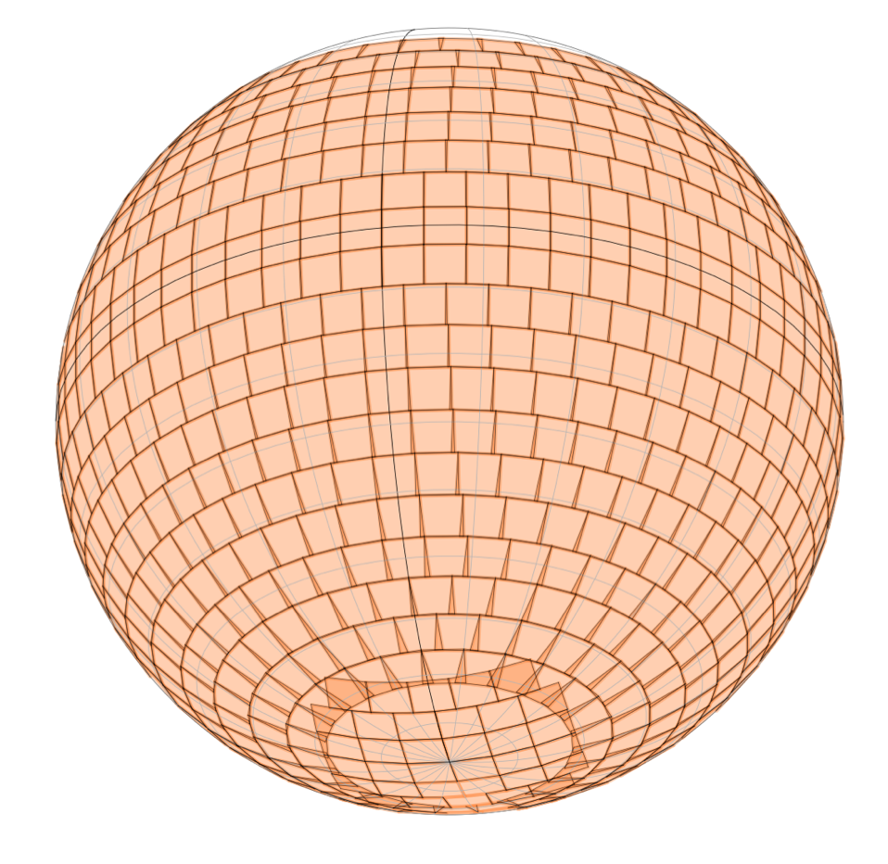
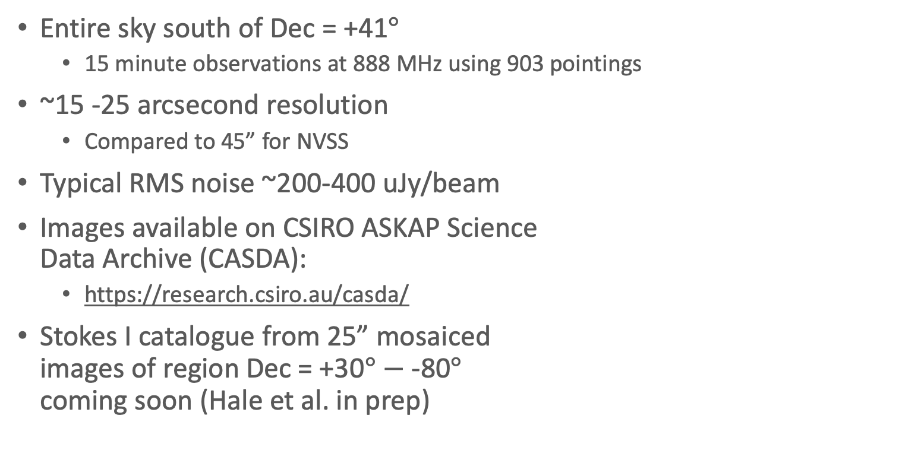
Rapid ASKAP Continuum Survey
McConnell et al. 2021, Hale et al. in prep
McConnell et al. 2021
Entire sky south of Dec = +41$°$
  15 minute observations at 888 MHz using 903 pointings
~15 -25 arcsecond resolution
  Compared to 45” for NVSS
Typical RMS noise ~200-400 uJy/beam
Images available on CSIRO ASKAP Science
Data Archive (CASDA):
  https://research.csiro.au/casda/
Stokes I catalogue from 25” mosaiced
images of region Dec = +30$°$ $−$ -80$°$
coming soon (Hale et al. in prep)
For more info see:
https://research.csiro.au/racs/
https://www.atnf.csiro.au/research/RACS/RACStour/index.html

Slide 14
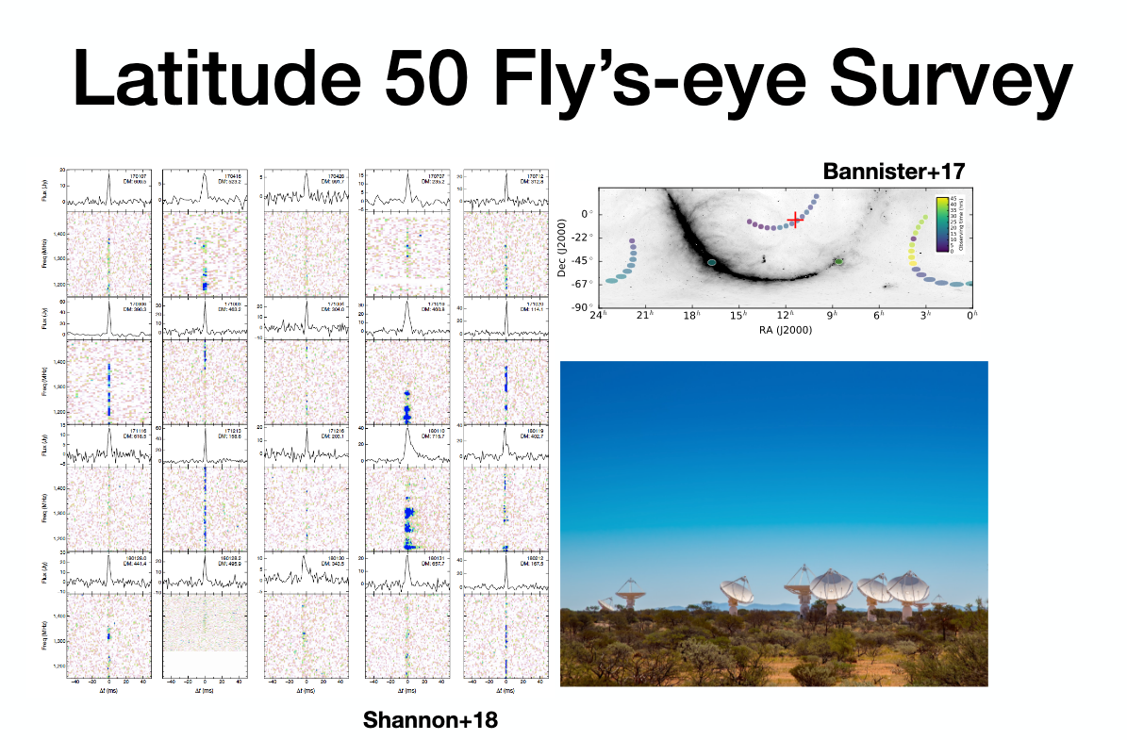
Courtesy of Keith Bannister

Slide 15
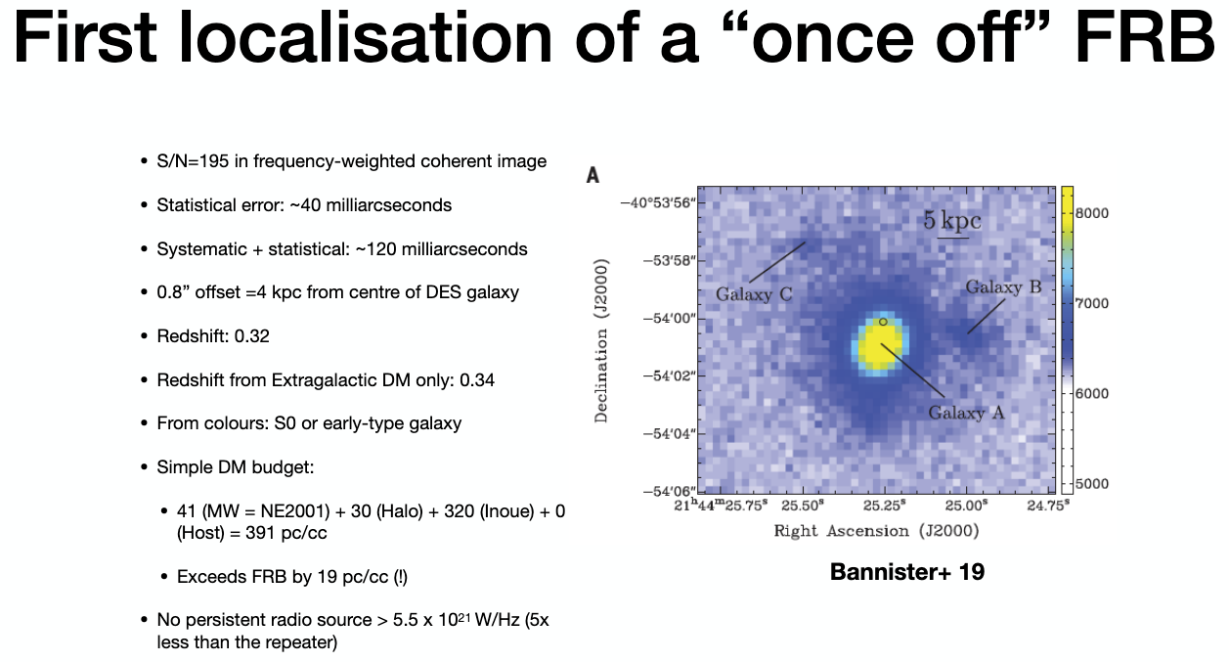
Courtesy of Keith Bannister

Slide 16
HI absorption
ASKAP – FLASH (blind wide)
MeerKAT-MALS (targeted)
MIGHTEE, LADUMA – deep narrow (associated absorbers mainly)
Courtesy of James Allison

Slide 17
New mosaic at 4” resolution over 6.5 square degrees
Compact source catalogue and data release in 2021
Heywood et al. 2019,. Nature
Notes:
Inflation of 430-parsec bipolar radio bubbles in the Galactic Centre by an energetic event
The right panel shows a part of the current mosaic, which has been consistently processed to give 4" resolution over 6.5 square degrees. It also has spectral information, with some false colour images of Sgr B2 and Sgr A inset to show this. There are countless new features in this mosaic, including many new non-thermal filaments and low angular diameter shells. Isabella Ramalla is producing a catalogue of compact objects. There'll be a public release of the image and catalogue products in 2021. Polarisation is to follow, but maybe only mention that if someone asks about it.
For the Sgr A inset you could also point out that the radio mini-spiral (ionised gas streams around Sgr A*) really stands out in the image because of its distinct spectrum.

Slide 18
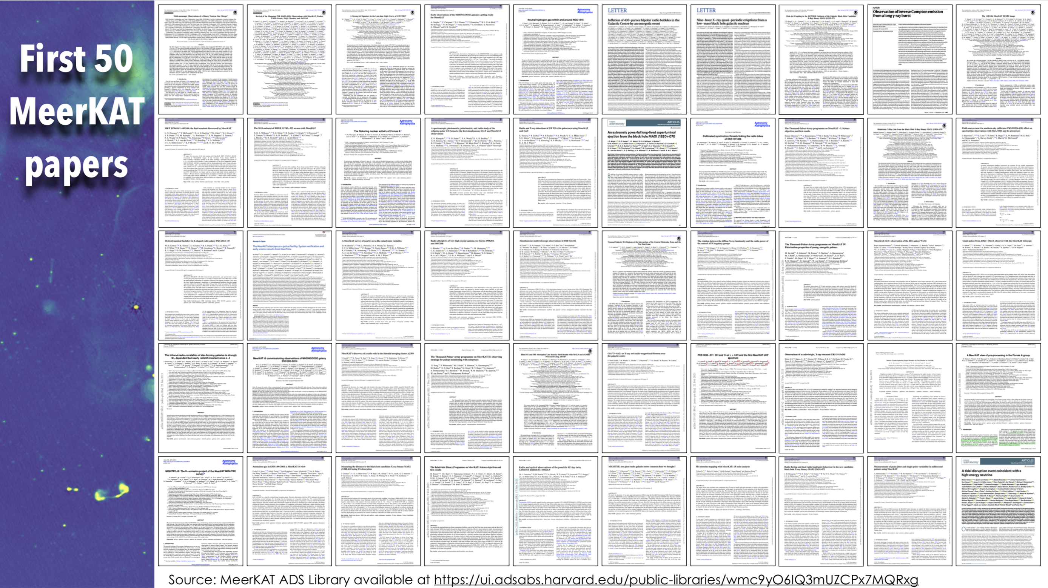

Slide 19
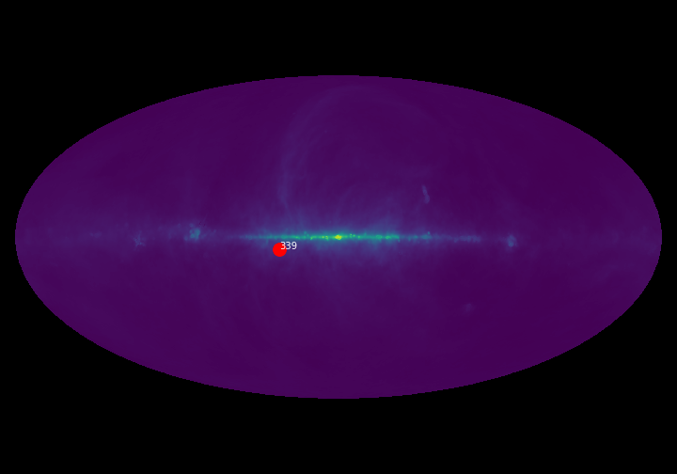
Transients with MeerKAT
Courtesy of Rob Fender
Bright et al., Nature Astronomy, 2020
Notes:
An extremely powerful long-lived superluminal ejection from the black hole MAXI J1820+070 using eMERLIN, MeerKAT and JVLA

Slide 20
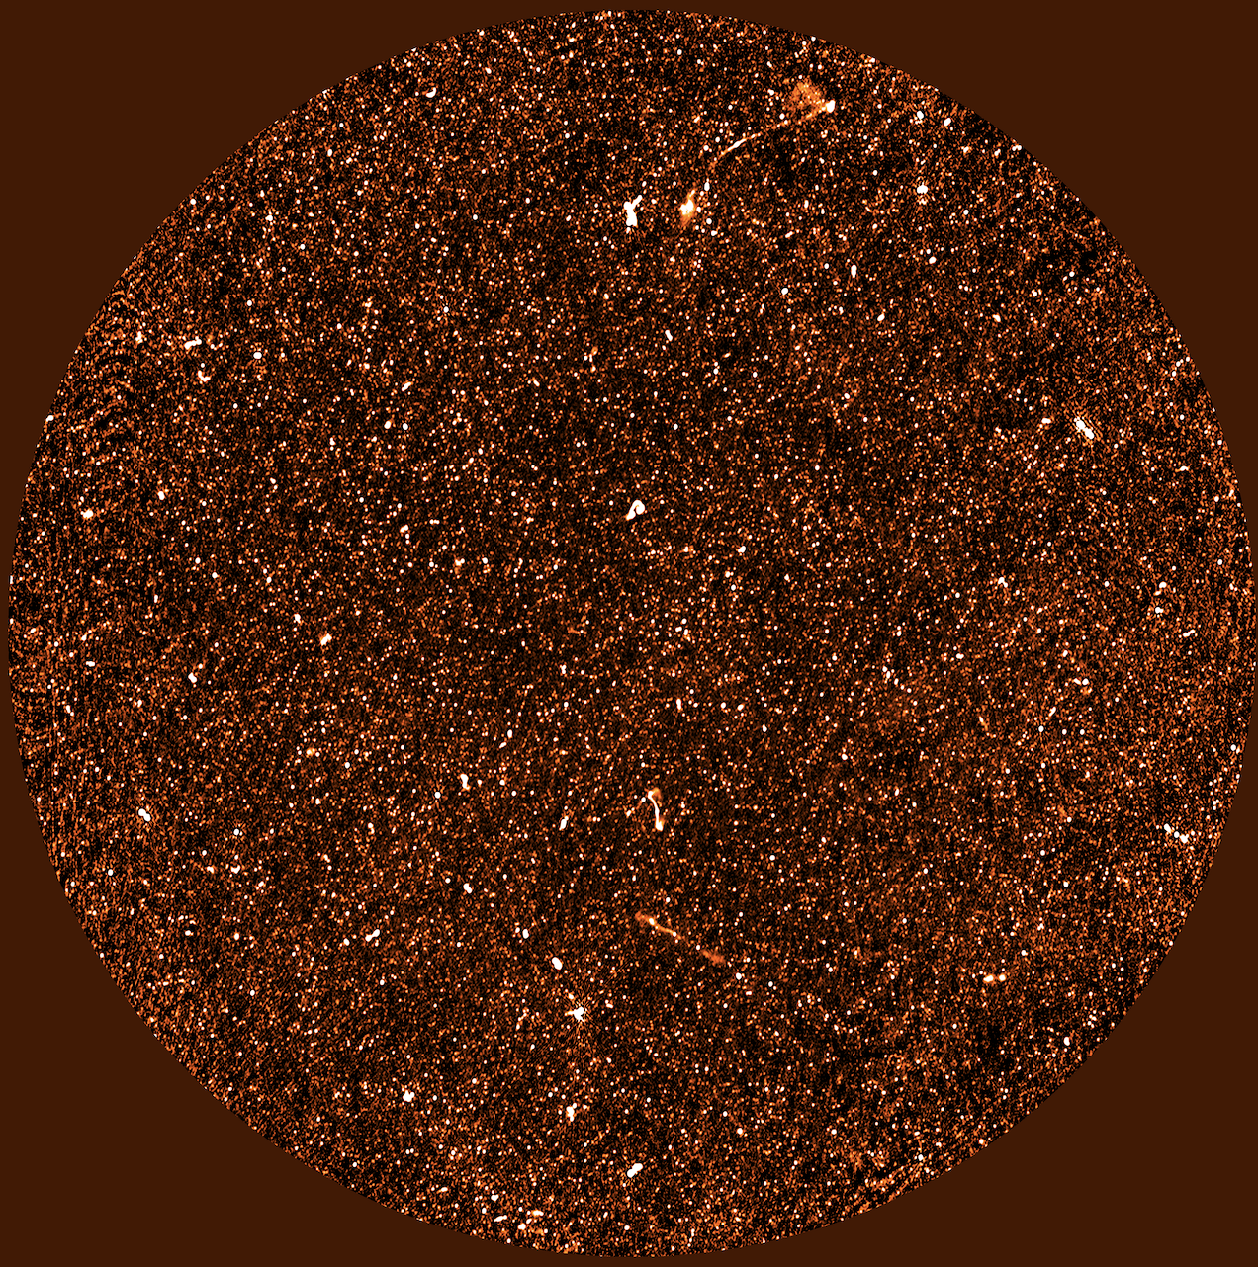
MIGHTEE deep continuum data…
Heywood et al. in prep
Jarvis et al. in prep.
1.5 sq.deg over COSMOS
1.8uJy from 16 hours on field at L-band
(cf VLA COSMOS 3GHz – 390hours reaches 2.3uJy – equivalent to ~4uJy at L-band)

Slide 21
MIGHTEE deep continuum data…
Heywood et al. in prep
Jarvis et al. in prep.
Given the baseline distribution of MeerKAT we can make images at a range of resolutions, trading off sensitivity.
We have produced images with
(i) 8.4 arcsec resolution rms = 1.8uJy (but limited by confusion)
(ii) 4.5 arcsec resolution rms ~ 6 uJy

Slide 22
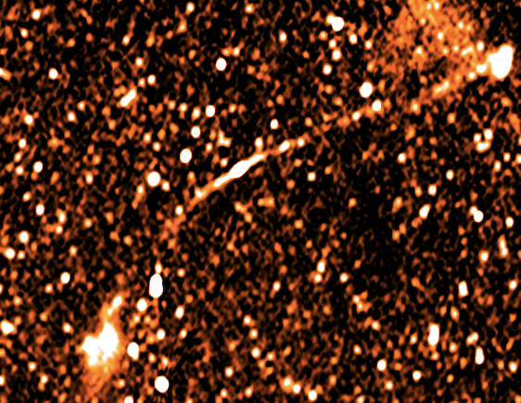
Giant diffuse radio galaxies in COSMOS (>2Mpc)
Delhaize et al 2021
A good example of what MeerKAT can do that the JVLA finds difficult
MIGHTEE (Heywood et al. in prep)
12 arcmin

Slide 23
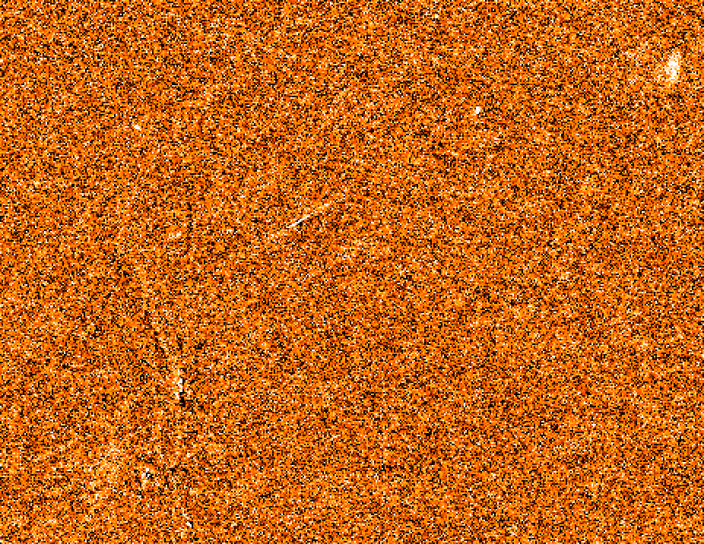
Giant diffuse radio galaxies in COSMOS (>2Mpc)
Delhaize et al 2021
A good example of what MeerKAT can do that the JVLA finds difficult
JVLA 3GHz (Smolcic et al. 2017)

Slide 24
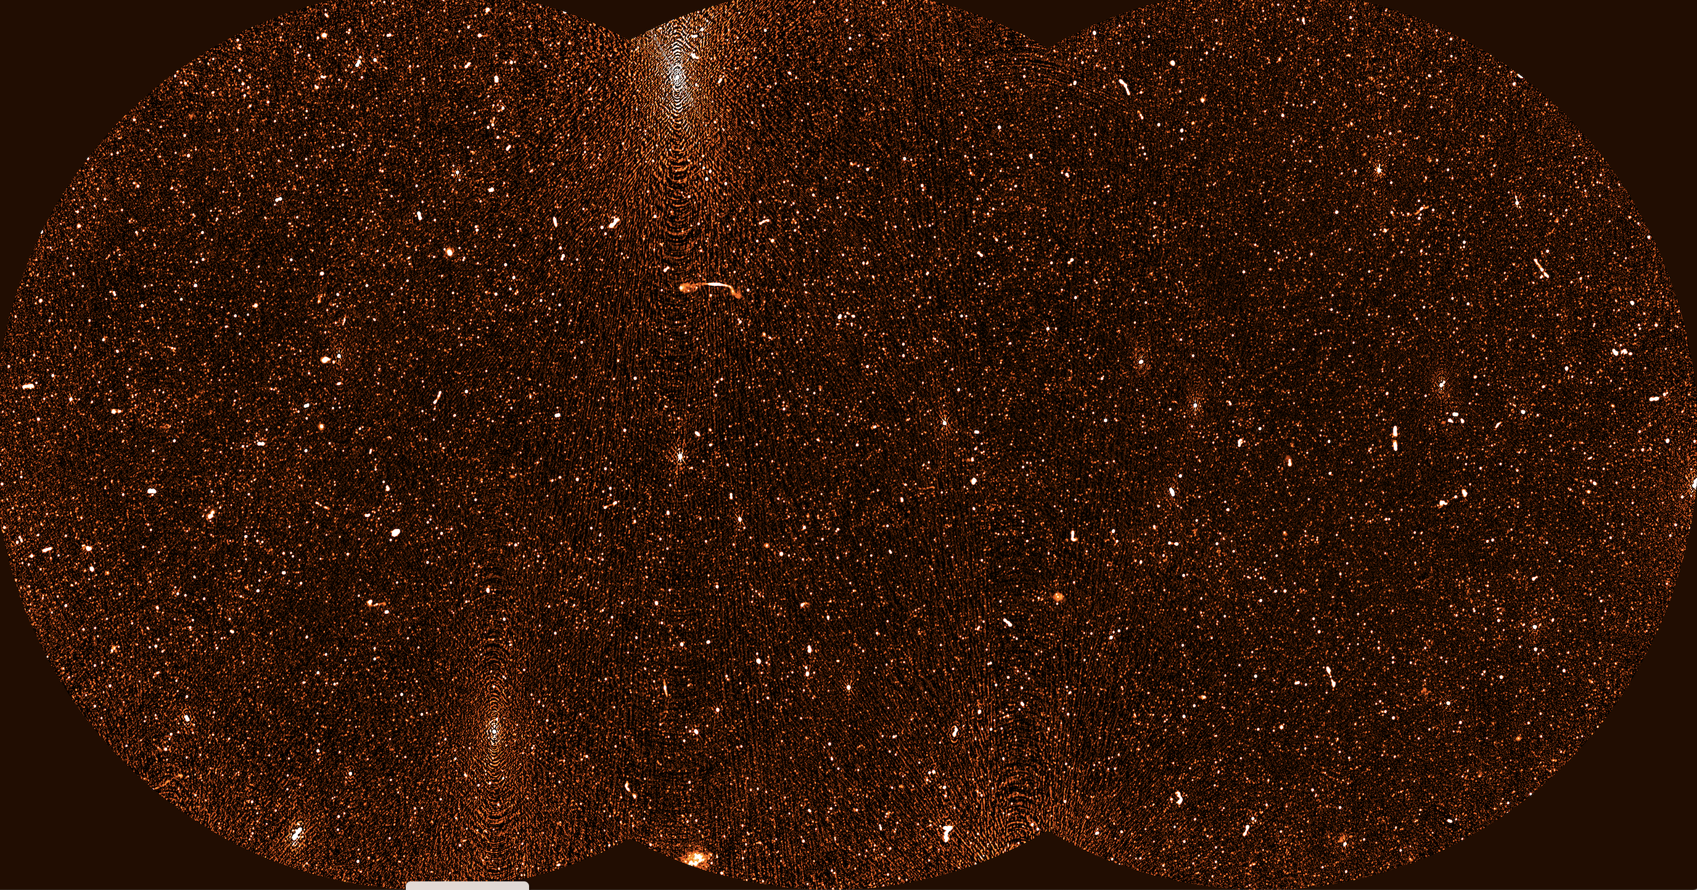
2019 Original XMMLSS MIGHTEE Mosaic

Slide 25
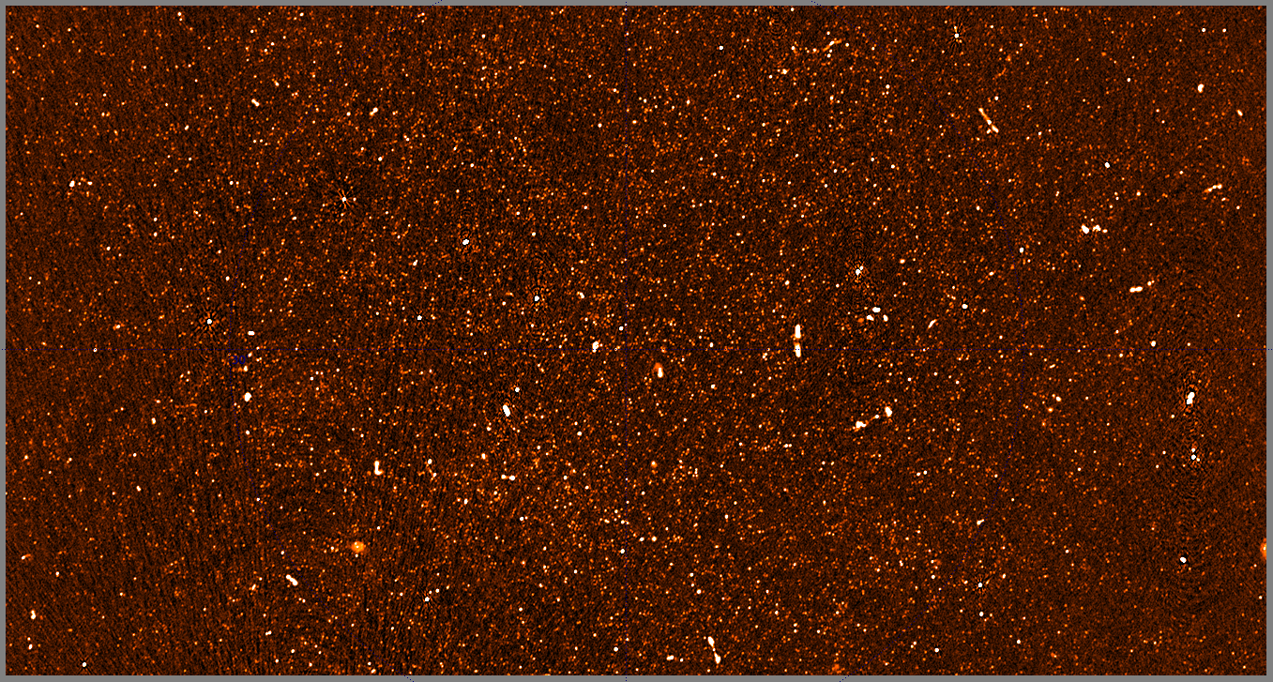
2019 vs 2020 XMM12 image with new calibration technique (Heywood et al. in prep.)

Slide 26
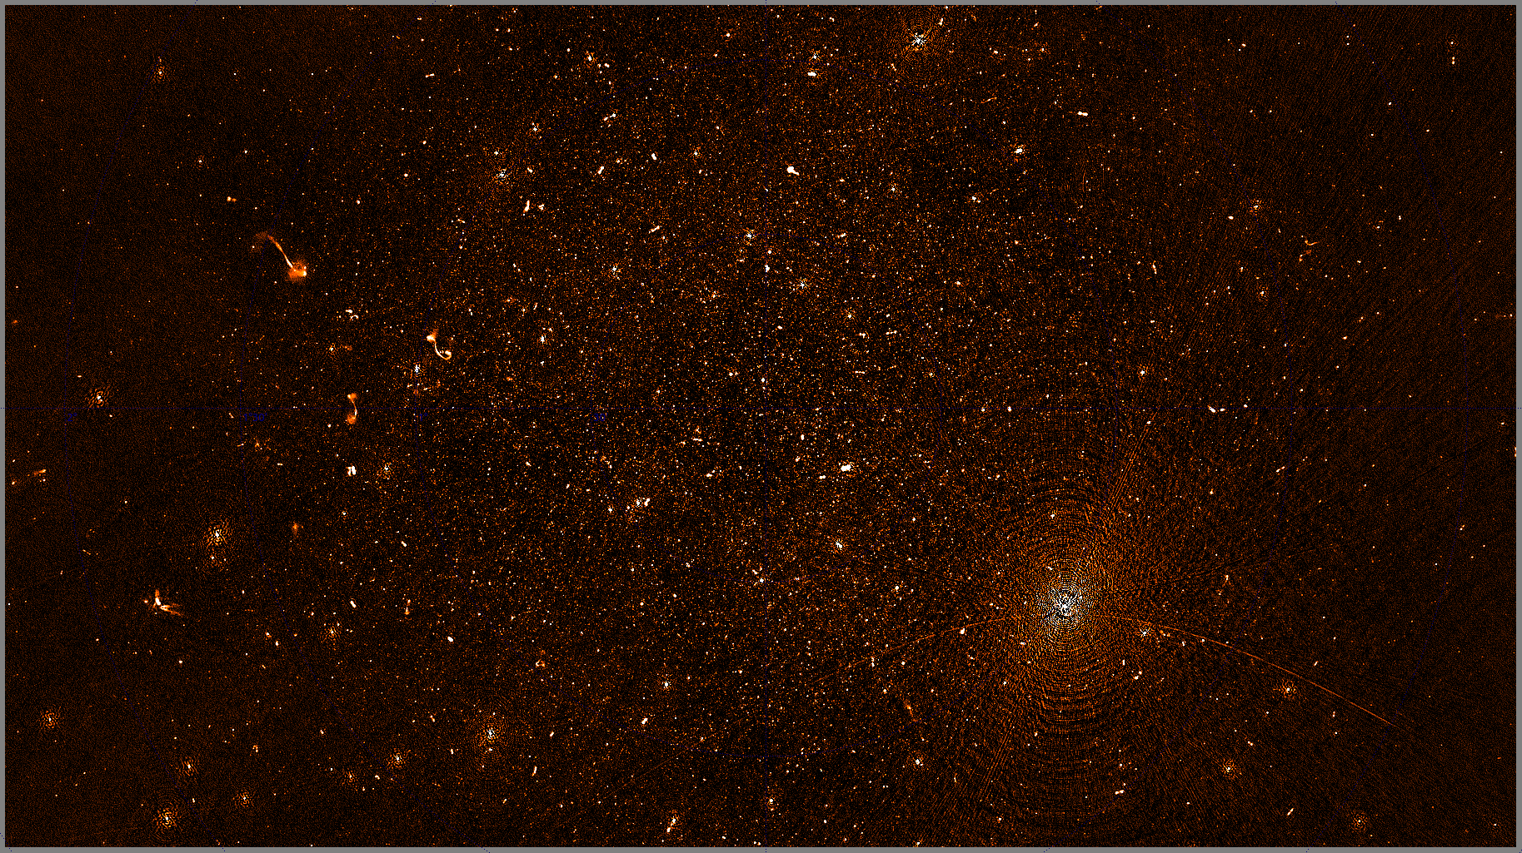
ECDFS-LADUMA Field at UHF

Slide 27
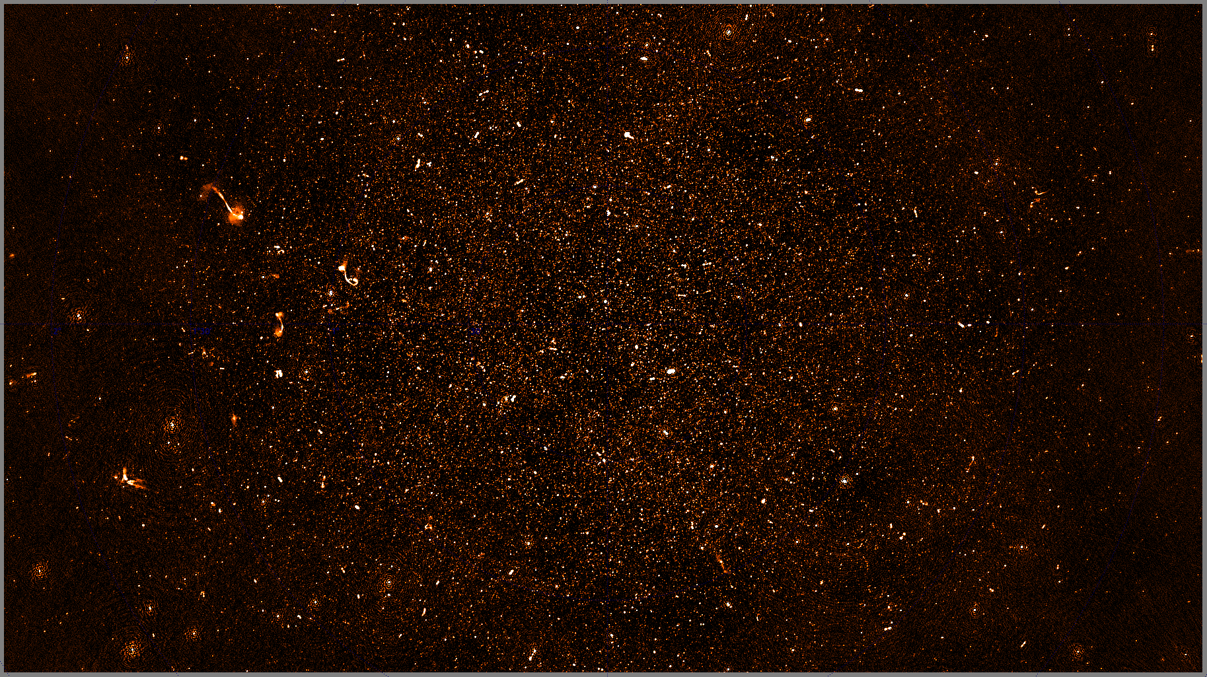
ECDFS-LADUMA Field at UHF

Slide 28
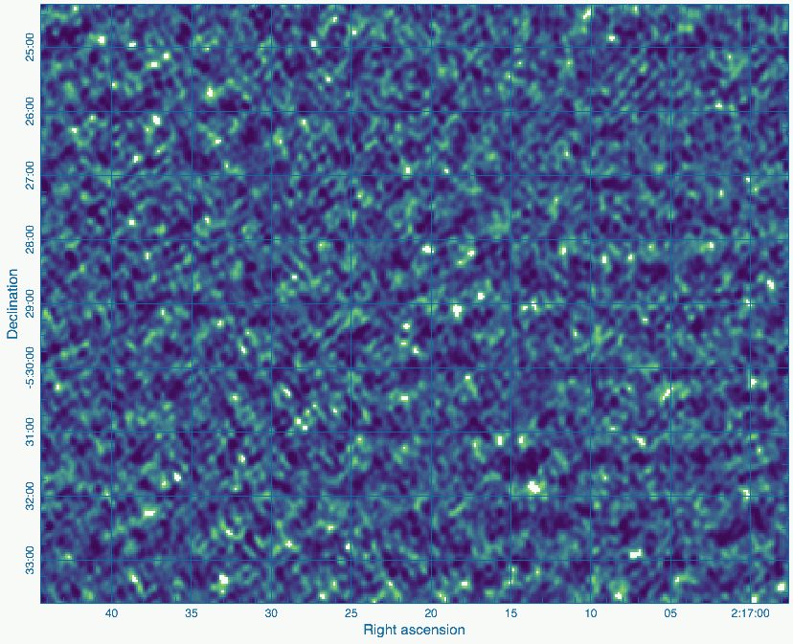
MIGHTEE-HI Early Science
Credit: Brad Frank, Natasha Maddox and the MIGHTEE HI team

Slide 29
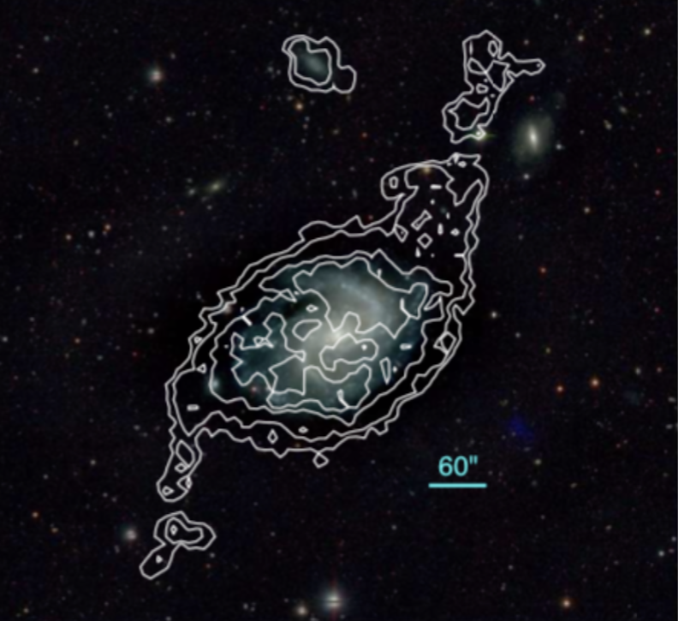
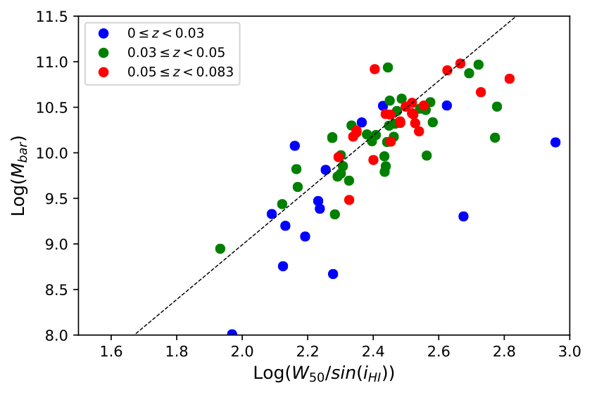
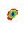
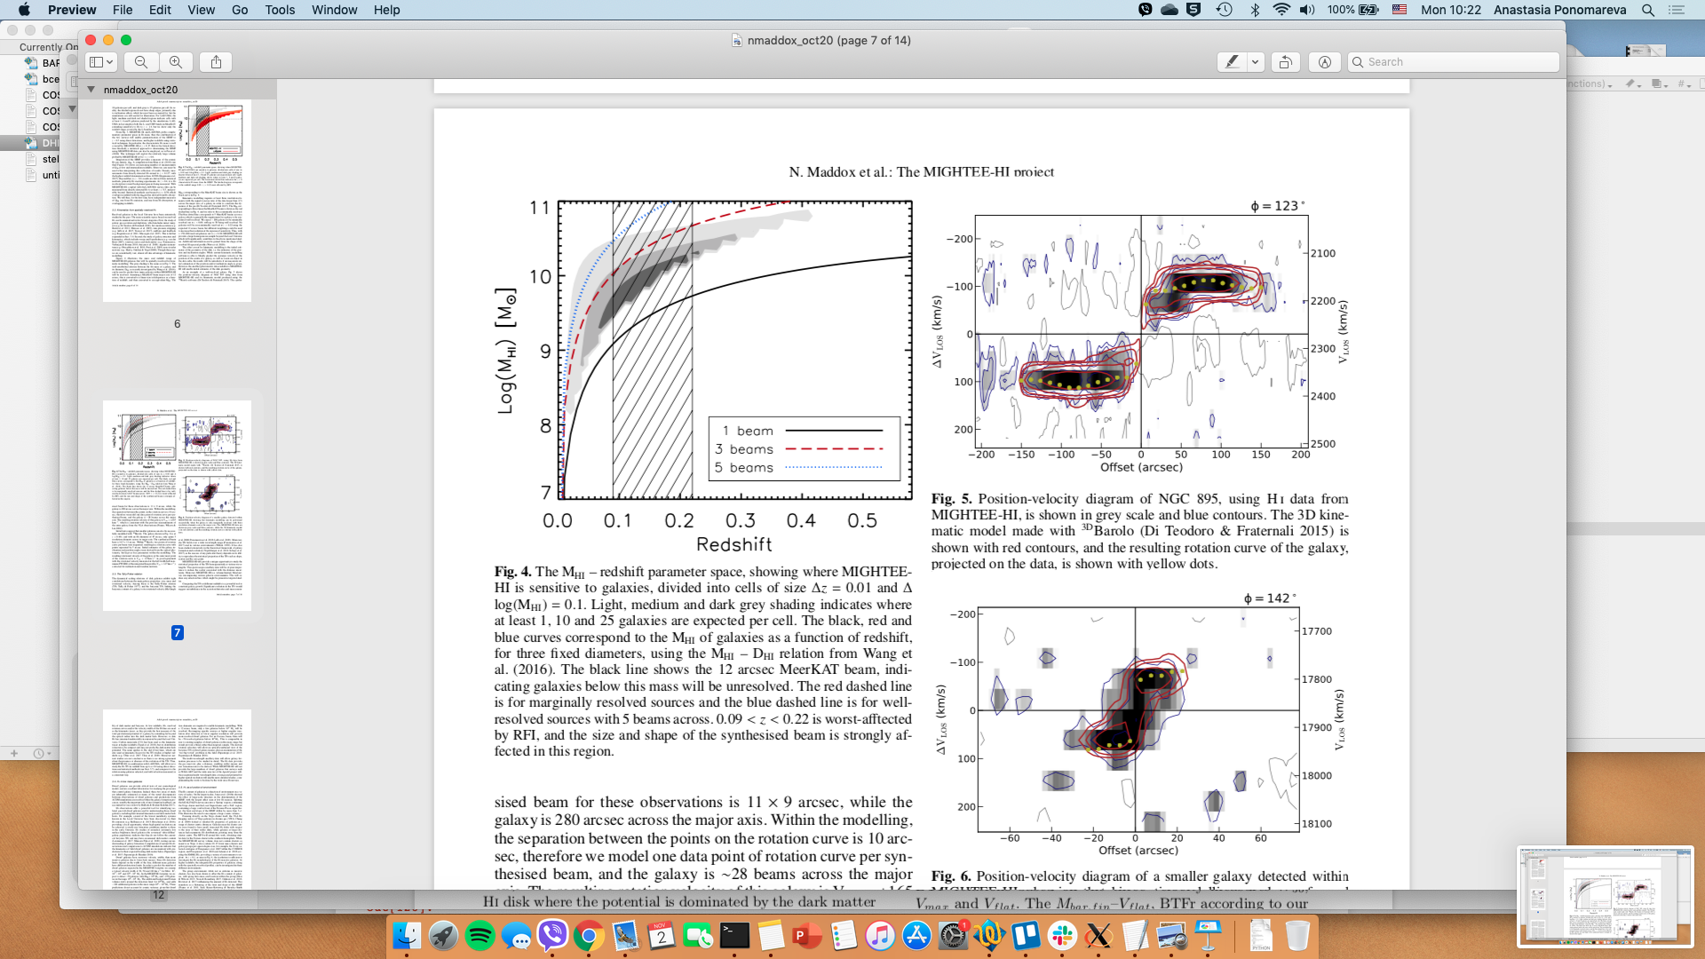

MIGHTEE-HI early science: Velocities
Fully Automated 3DBarolo (DiTeodoro+15):
102 objects with reliable RESOLVED kinematics
Properties: Vrot(R), Incl(R), PA(R), $σ$(R), $Σ$(HI)
Caveats:
Velocity resolution ~44 km/s
z = 0
MHI= 1.7 x 10¹⁰
28 beams across
No evolution of the TFr up to z = 0.083
z = 0.06
MHI= 1.8 x 10⁹
3 beams across
Ponomareva+ in prep

Slide 30
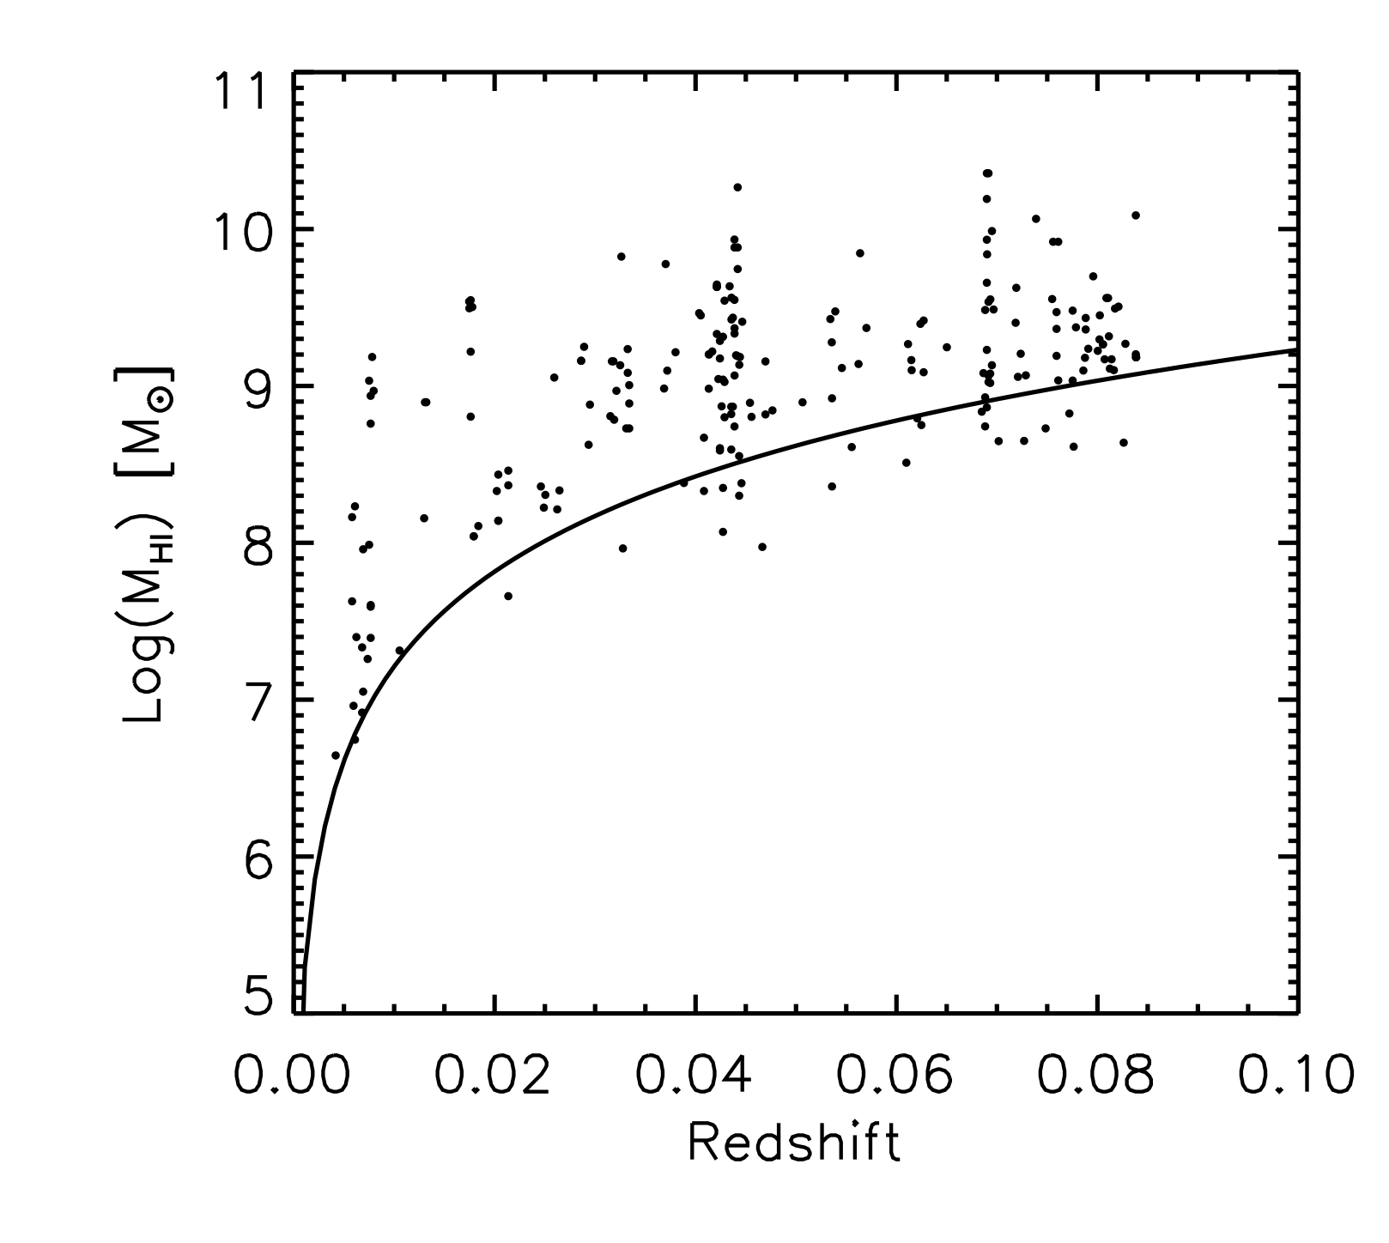
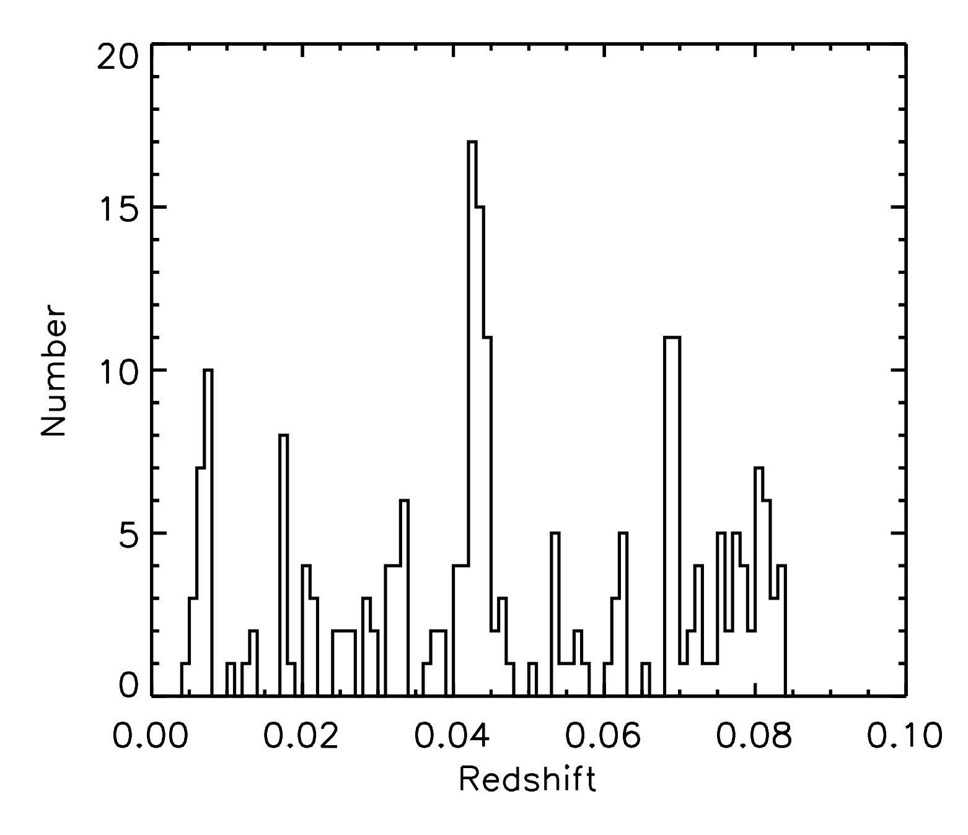
Observations already shows LSS in XMMLSS field
Overdensity
Group
RFI
ALFALFA z limit

Slide 31
Summary
Pathfinders and precursors are doing key elements of SKA science now
Information from all of them fill in key aspects of what the SKA aims to do
Many of these projects and surveys are limited by human resource, so plenty of opportunities to get involved
Working with the data from these telescopes now is possibly the best preparation for working with the SKA
Many of the chapters in the 2015 science book are being addressed, however, reality bites on theoretical noise limits and dynamic range when dealing with the real data – so important lessons are being learnt.
Continually learning about how to deal with these data!

