Slide 1
SKA UK Town Hall Programme Update
Robert Braun, Science Director
2 March 2021

Slide 2
SKA Update
SKAO Membership
SKA Organisation to Observatory Transition
Gearing up for Construction
Gearing up for Operations

Slide 3
SKAO Membership
Fully ratified SKAO Members:
Australia, Italy, Netherlands, Portugal, South Africa, UK
Soon to be ratified Members:
China (signatory): expected end Q1 2021
Sweden: expected Q1 2021
India: expected Q2/Q3 2021
Canada: government approval expected March 2021, ratification to follow
Formal membership negotiations now underway:
Germany: via BMBF
France: via Ministry of Research
Spain: via Ministry of Science
Slightly longer term / interim cooperation agreements (ICA)
Switzerland: ICA with EPFL expected Q1/2 2021
South Korea: ICA with KASI expected Q2 2021
Japan: ICA with NAOJ under discussion

Slide 4
SKAO Membership

Slide 5
SKA Organisation to Observatory Transition
SKA Council-1 (Feb 2021)
SKAO has entered into force but is an empty vessel
UK Headquarters Agreement
Treaty level document signed and now (22 February 2021) laid before UK Parliament
SKA Council-2 (Apr 2021)
Expecting approval to enact transition via Business Purchase Agreement
May 2021
Transition of staff and assets to SKAO makes it a fully operational entity

Slide 6
SKA Construction Readiness
SKA Council-1 (3 – 4 Feb 2021) reaffirm commitment to build and operate the SKA-1 Design Baseline
Large fraction, but not all, of first 10 years of funding (COFS) already identified
Staged contracting plan to manage commitments against funding availability (as is normal for large projects)
Construction Proposal to go to Council for approval decision at Council-3 in June 2021

Slide 7
SKA Construction Readiness
Pre-procurement planning proceeding at pace
Cost book being updated to 2021 economic conditions
Contract with NRC in place for Talon Development Correlator work
Low Station:
Funding provided (Aus) to develop updated design to solve non-compliance issues with Smartbox
Additional external funding (Italy) to support design maturity of antennas for manufacture
Dish structure:
Continue to work with partners to deliver the Dish Structure CDR
Mitigation plans under development

Slide 8
SKA Construction Readiness
ECP-200039: COTS solution for implementation of Low CBF
Provides greater scalability, flexibility and lower risk (full compliance with engineering sub-arrays, sub-stations, bandwidth constraints) along with reduced costs, effort and schedule
Working to resolve delivery plan details and division of work
ECP-200048: Move Mid CSP from site to Cape Town SPC
Benefits include relaxation of power consumption at site, increased maintainability and access to staff for support, reduction in EMI screening, improved safety in construction and operations, increased flexibility in capability (sharing of compute between SDP, PSS)
Implementation plan underway with all stakeholders

Slide 9
SKA Contract Preparation
Touch-point | Jan ‘21 | Feb ‘21 | Mar ‘21 | Apr ‘21 | May ‘21 | Jun ‘21 | Jul ‘21 | Aug ’21 | Sep ‘21 | Oct ‘21 | Nov ‘21 | Dec ‘21 | Full year 2022 | Full year 2023
PR | All
CRRs (43) |  | Mid CSP & CBF; Low Station Mgt & Int.; Software Sole Source | Mid Infra PSC; Mid Infra 1; Mid Infra 2; Mid Infra 3; Mid Infra 4; Mid Dish PSC; Low Infra PSC; Low Infra 1; Low Infra 3; Low Infra 6 | Software Comp. | Mid S-AIV; Low CSP; Low SPC; Low Infra 2; Mid Timing | Mid B2; Low Timing | Mid B1; Mid Dish Structure | Mid SPF Services; Mid SPFRx; Low Antenna Ass.; Low PaSD; Mid Infra 6 | Mid Cryo; Mid & Low Clocks; Low Station Dep.; Low Infra 5; Low S-AIV | Low SPS | Mid B5 |  | Mid Infra 5; Mid Networks; MeerKAT Integration; Mid CPF; Low Networks; Low CPF; Low PPA | Mid SPC
TEPs start review of tenders (56) |  |  | Mid CBF | Mid Infra PSC; Mid Dish PSC; Mid CSP; Low Infra PSC; Low Station Mgt & Int.; Software Sole Source (7?) |  |  | Software Comp. (7?) | Mid B1; Mid S-AIV; Low Timing | Mid Infra 4; Mid Dish Structure; Low Infra 1; Low Infra 6 | Mid Infra 1; Mid Infra 2; Mid Infra 3; Mid B2; Low Infra 2; Low Infra 3; Low Infra 5 | Mid Timing; Low CSP; Low SPC | Mid SPFRx | Mid Infra 5; Mid Infra 6; Mid B5; Mid Cryo; Mid SPF Services; MeerKAT Integration; Mid & Low Clocks; Low Station Dep.; Low Antenna Ass.; Low PaSD; Low SPS; Low S-AIV; Low PPA | Mid Networks; Mid SPC; Mid CPF; Low Networks; Low CPF
C0s (56) |  |  |  |  |  |  | Mid Infra PSC; Mid Dish PSC; Mid CBF; Low Infra PSC; Low Station Mgt & Int.; Software Sole Source (7?) | Mid CSP | Software Comp. (7?) |  | Mid Infra 4; Mid S-AIV; Low Infra 1; Low Infra 2; Low Infra 6 | Mid B2; | Mid Infra 1; Mid Infra 2; Mid Infra 3; Mid Infra 5; Mid Infra 6; Mid Dish Structure; Mid B1; Mid B5; Mid Cryo; Mid SPF Services; Mid SPFRx; MeerKAT Integration; Mid & Low Clocks; Mid Timing;; Low Infra 3; Low Infra 5; Low Station Dep.; Low Antenna Ass.; Low PaSD; Low SPS; Low Timing; Low CSP; Low S-AIV; Low PPA; Low SPC | Low CPF; Mid Networks; Mid CPF; Low Networks; Mid SPC (2024)
KEY:
Ben = red
André = gold
Maurizio = brown
Du Bruyn = black
Mark = blue
David = green
Peter = orange
Jacque = pink
Jill = purple
Adriaan = yellow
Unassigned = grey

Slide 10
SKA Construction Contract Preparation

Slide 11
SKA Ops AU/ZA staffing
Telescope Director applications closed Feb 8
Very strong candidates
Collaboration MoUs are complete
Common understanding with CSIRO / SARAO
Detailed staffing / recruitment tables
Construction, Operations, Business Enabling
Tripartite / bipartite work on recruitments
Incl. dedicated SKAO/CSIRO/SARAO HR expert
Focusing on 2021

Slide 12
AU/ZA Host country facilities
EOC, SOC, SPC (+BAF in AUS) requirements
Staff numbers, locations, work patterns
Computing infrastructure, space
Workshops
Multiple stakeholders, delivery models, cost models
Will also need interim arrangements

Slide 13
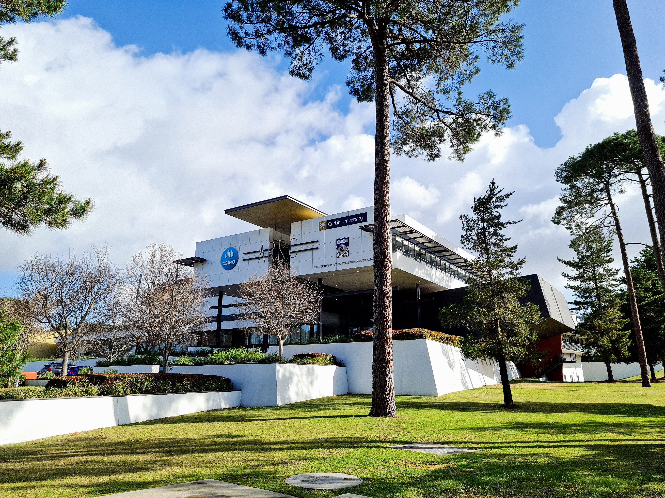
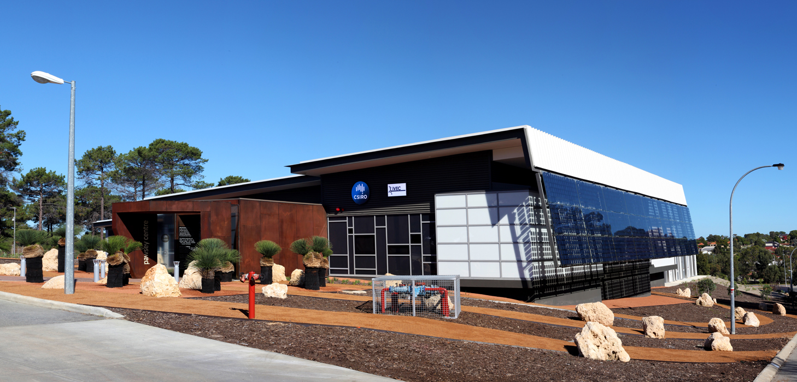
ARRC Building – SOC
Pawsey Centre - SPC

Slide 14
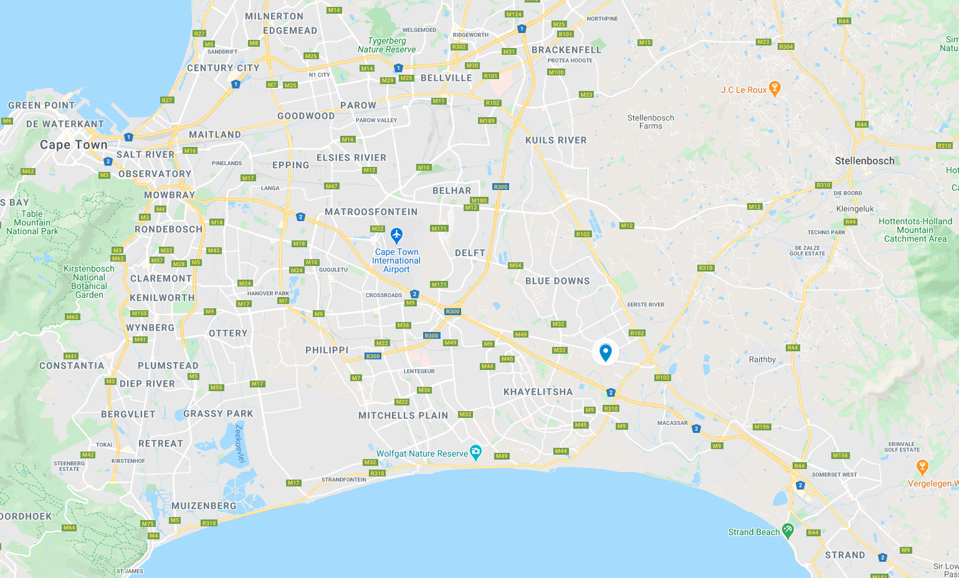
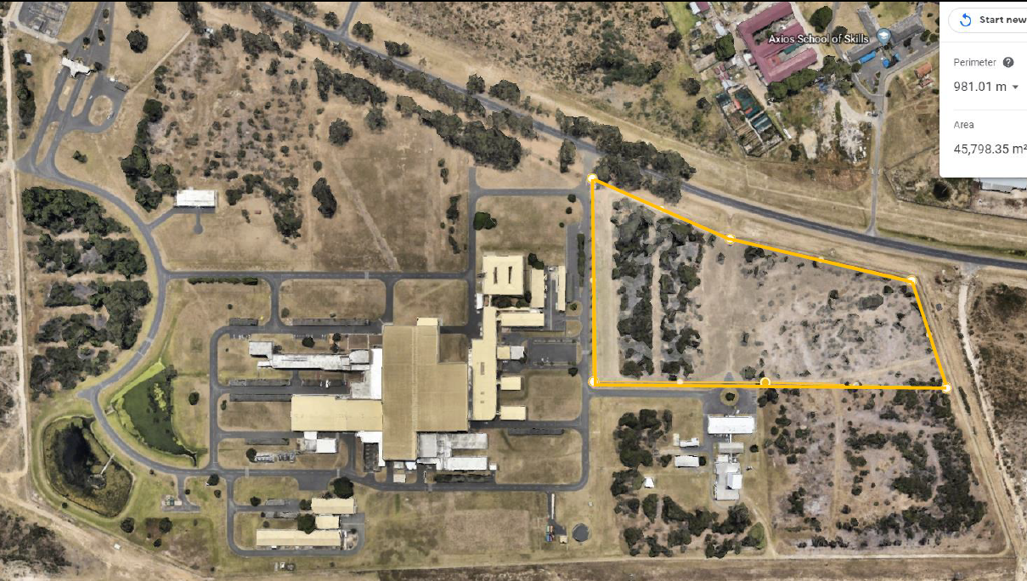
SARAO/SKAO
iThemba LABS
iThemba LABS
Mid SOC, SPC – NRF iThemba LABS, Cape Town
Notes:
10,000 m2 building

Slide 15
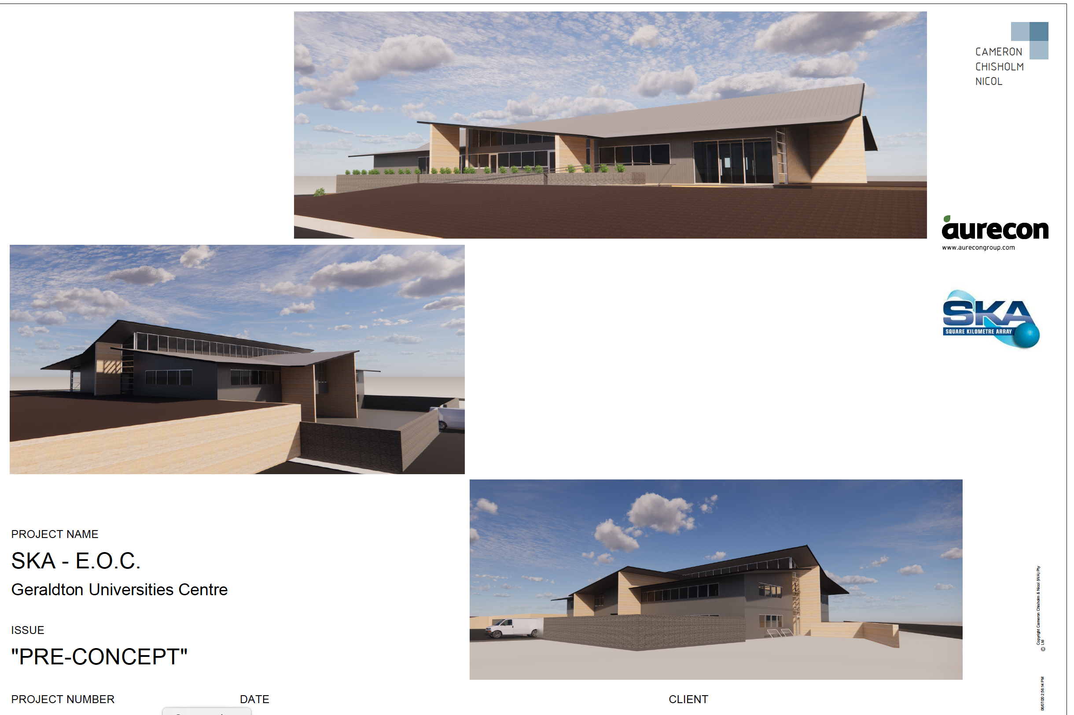
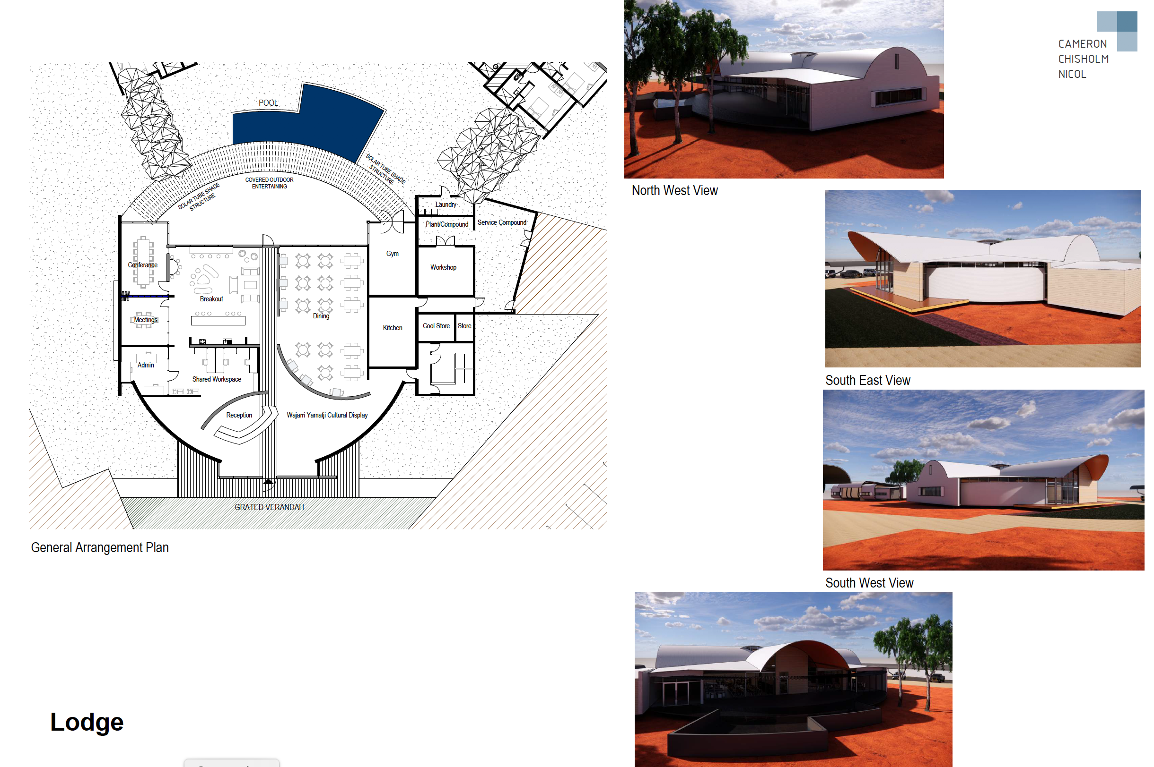
Boolardy Accommodation Facility

Slide 16
AU/ZA Power procurement
SKA-Mid site – Grid
Pursuing PV & northern powerline
SKA-Mid SOC/SPC – Grid
Pursuing PV & wheeling
SKA-Low site – No grid
Pursuing PV
SKA-Low SOC/SPC – Grid
Will consider wheeling
Progressing towards RfP for Power Purchase Agreements
Close cooperation with SKAO RFI team
CSIRO and SARAO heavily involved
Aurecon: AU, and Zutari: ZA, engaged as design consultants
RFI consultants and shielding manufacturers briefed

Slide 17
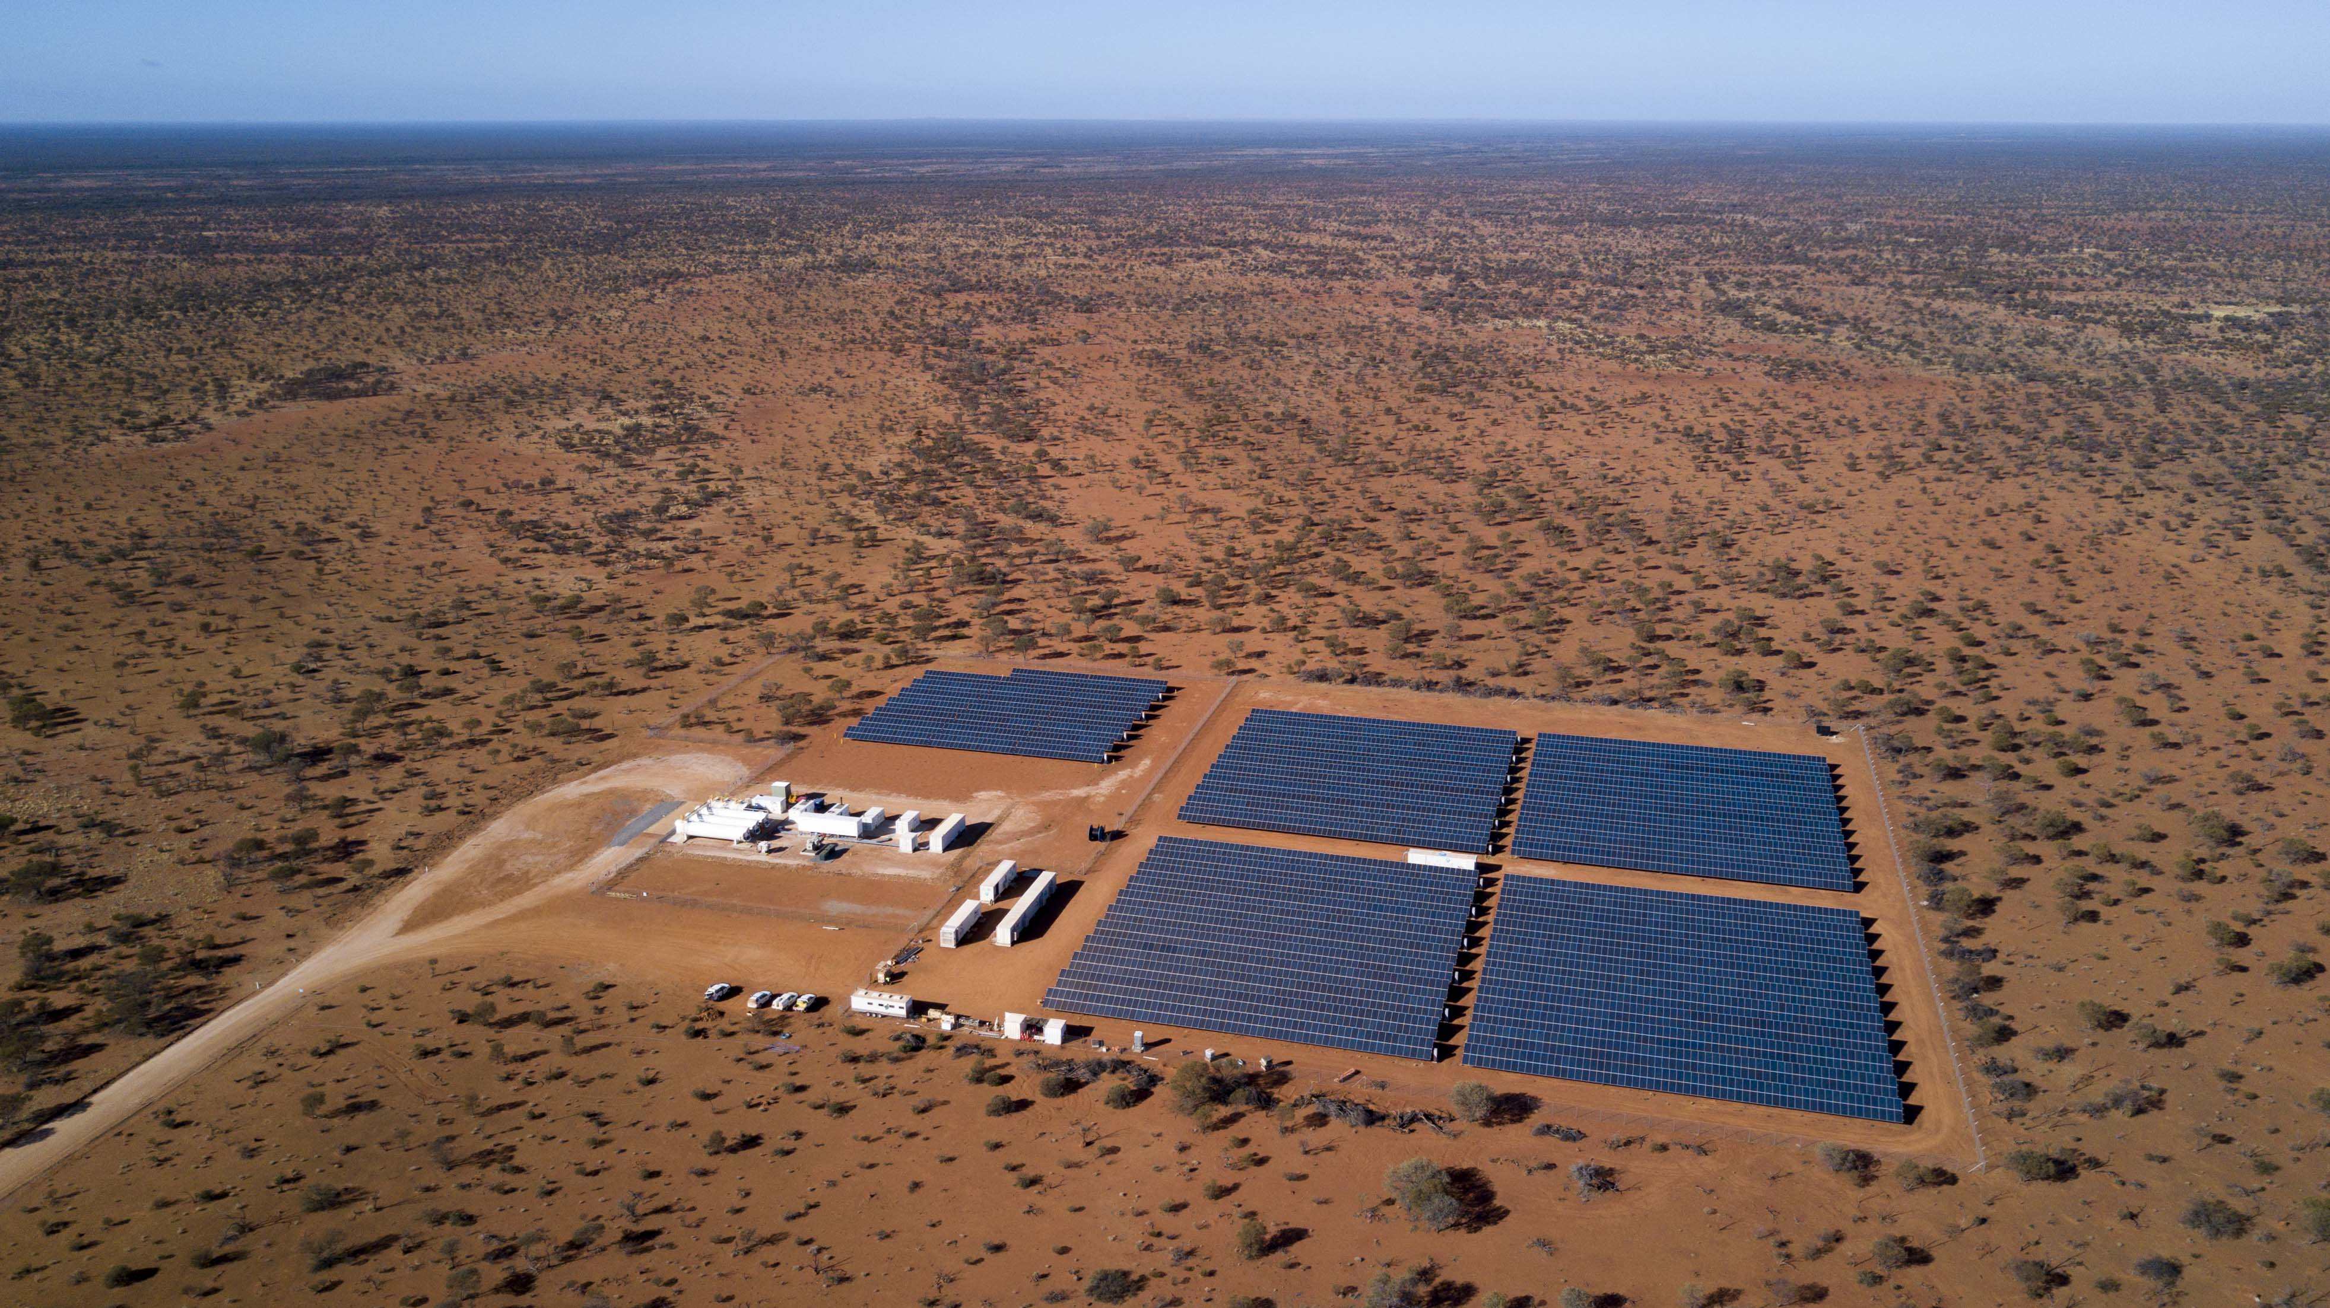
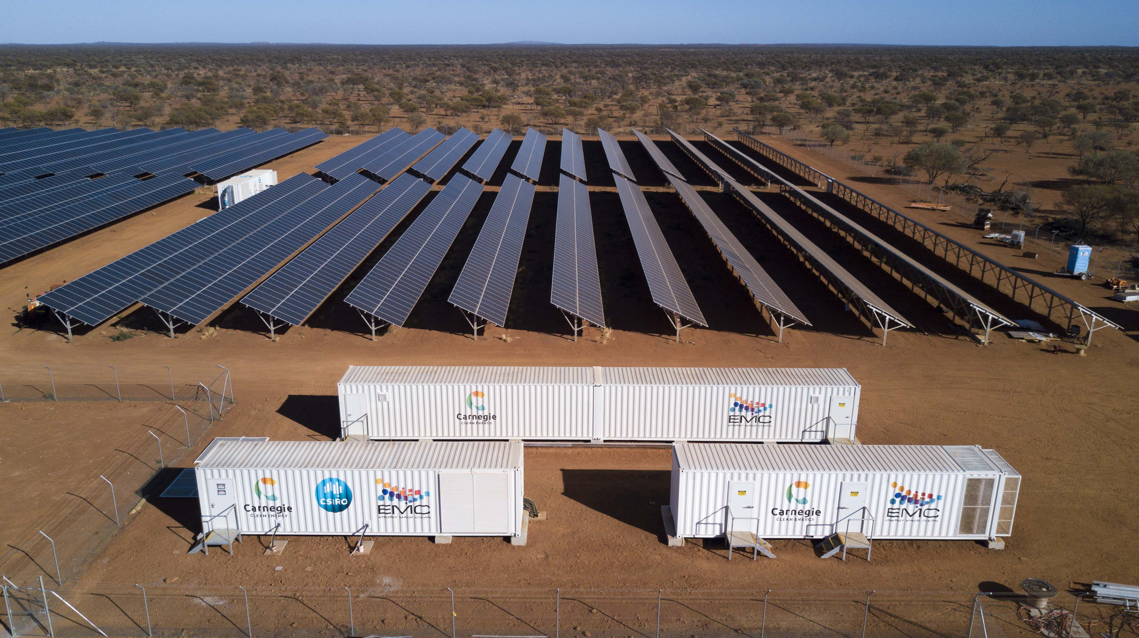
Notes:
2 MW PV
2.5 MW h BESS (1 MW peak)

Slide 18
SARAO/SKAO
PV
iThemba LABS, Cape Town
Notes:
10,000 m2 building
35,000 m2 for PV station with capacity of 7 MW
BESS
SOC + SPC + SRC ~ 4 MW

Slide 19
Ops SRC Network
SRCSC Working Groups now active
Architecture – SRC Arch, (Kitaeff)
Data Logistics – Bolton, An
Operations – Chrysostomou, van Haarlem
SW, fed. comp. & data – Vilotte, Wadadekar
Science archive – Verdes-Montenegro, Gaudet
Compute – Ratcliffe, Barbosa
Science user engagement – Possenti, Klockner
Focus is on roadmaps / Task Lists
Progressing, but delayed ~6 months
SKAO SRC Architect interviews now underway

Slide 20
Questions?

